Slide 1
SMART LED LAMP
Submitted By:
Naveen Bhardwaj
Gagan Chawla
Nikhil Kumar Sharma
Under Guidance of:-
Ms. Savita Sharma

Slide 2
ABSTRACT
The project aims to develop a smart LED lighting system, which is remotely controlled by Android apps via handheld devices, e.g., smartphones, tablets, and so forth. A color pallet is shown on the app from which the user can select a color combination to be emitted by LED Bulb.

Slide 3
INTERNET OF THINGS (IoT)
The Internet of things (IoT) is the network of physical devices, vehicles, and other items embedded with electronics, software, sensors, actuators, and network connectivity which enable these objects to collect and exchange data.
The IoT allows objects to be sensed or controlled remotely across existing network infrastructure, creating opportunities for more direct integration of the physical world into computer-based systems.

Slide 4
Lifetime of LED
The useful life of LED lighting products is defined differently than that of other light sources, such as incandescent fluorescent lights(CFL). LEDs typically do not burn out or fail. Instead, they experience ‘lumen depreciation’, wherein the brightness of the LED dims slowly over time.
LEDs and Heat
LEDs uses heat sinks to absorb heat produced by the LED and dissipate it into the surrounding environment. This keeps LEDs from overheating and burning out. Thermal management is the factor responsible for the successful lifetime of the LED.

Slide 5
Advantages of Smart LED Lamp
It can produce colors over 16m colors. We can select the exact color we want by tapping a color in the app.
Variable Intensity: We can dim the Bulb without having to install dimmer switches in our home.
It can be controlled from anywhere. This means you don’t have to search for switches anymore.
It can help us sleep better. We can reduce the Bulb’s blue light emission for sleeping mode.
Power Saving
Hue Light
Interior Design

Slide 6
Flow of Data
The user can choose between sliders or color pallet to select the color.
The app convert the selected Red, Green and Blue color values into an RGB integer.
This RGB integer is then transferred to the web server hosted by Arduino in the same network using a http request such as:
http://192.168.43.63:80/?Color=16711680;/
The Arduino interfaced with ESP8266 receives the color value and decode it into red, green and blue separate values.
Then these values are written on corresponding red, green and blue pin.

Slide 7
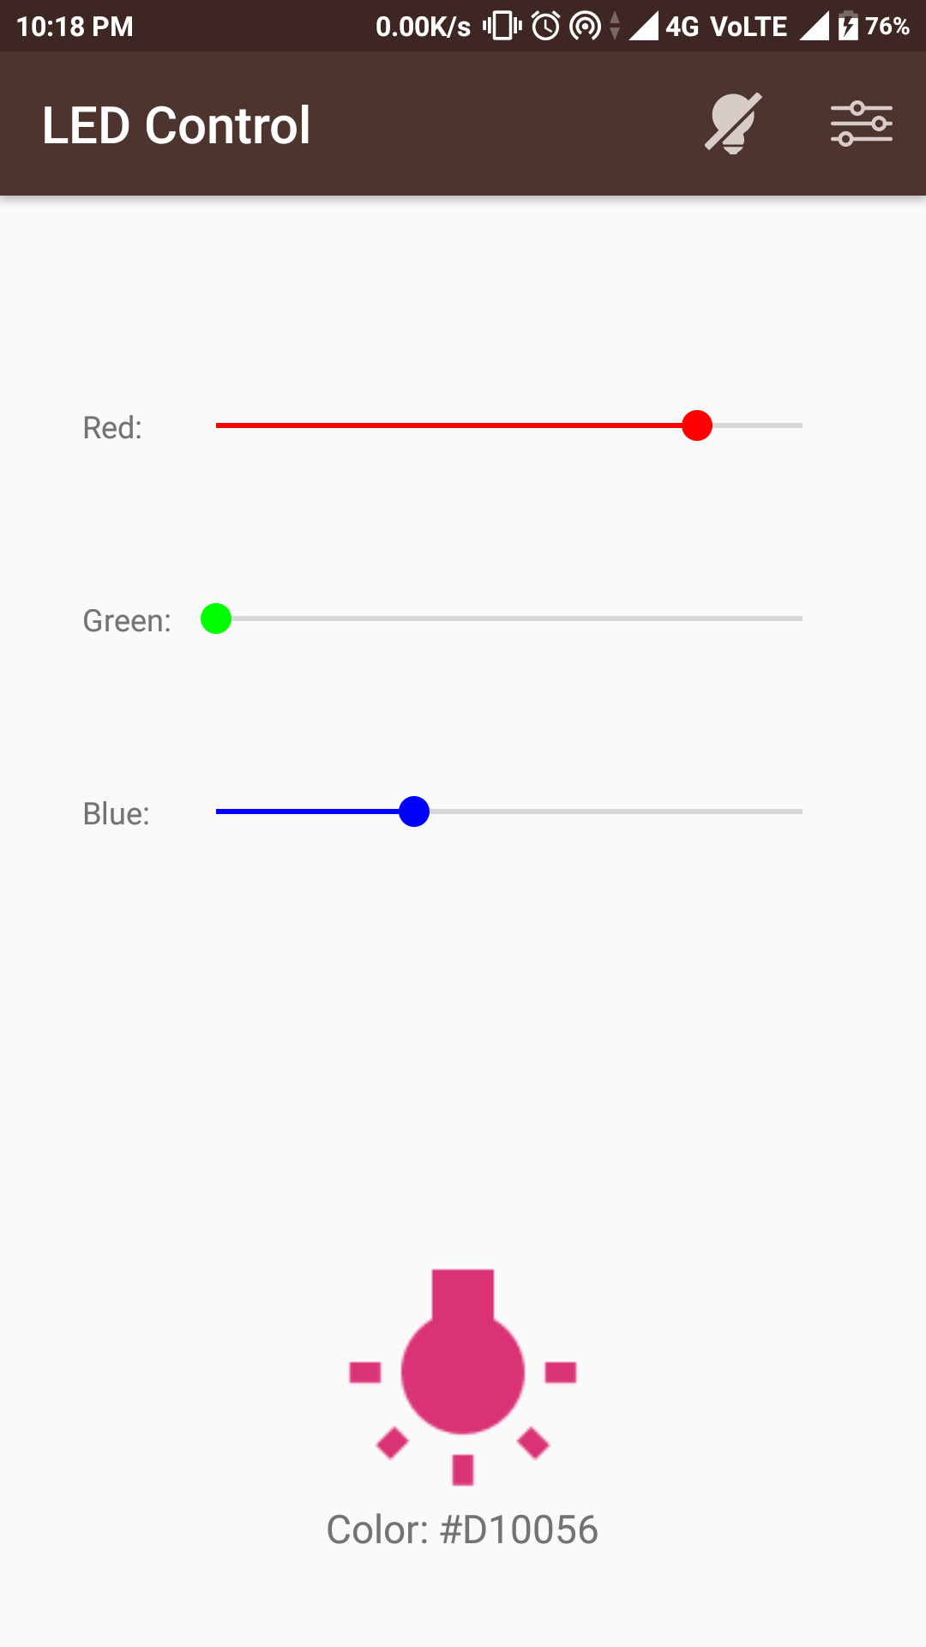
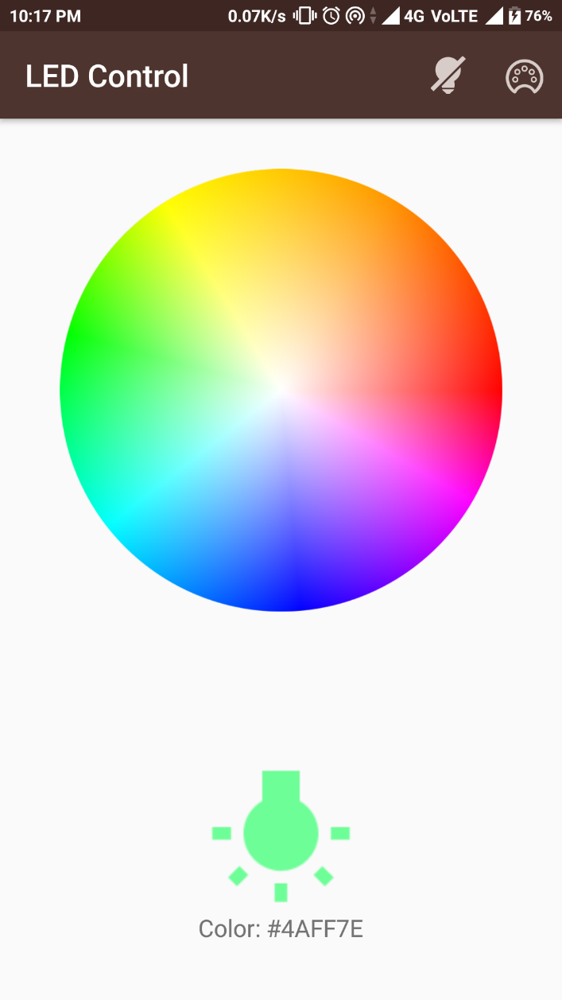
Front End Android App

Slide 8
RGB Encoding:
Create long integer RGB equals to red color value.
Long int RGB = red;
Bitwise left shift 8 bits of RGB and add green color value.
RGB = (RGB<<8)+green;
Again Bitwise left shift 8 bits of RGB and add blue color value.
RGB = (RGB<<8)+blue;

Slide 9
RGB Decoding:
Bitwise right shift 16 bits of RGB and then bitwise AND with 255 to get red value.
int red = (RGB>>16) & 0xff;
Bitwise right shift 8 bits of RGB and then bitwise AND with 255 to get green value.
int green = (RGB>>8) & 0xff;
Bitwise AND the RGB value with 255 to get blue value.
int blue = RGB & 0xff;

Slide 10
Example:
Suppose we have 3 colors values as:
Red = 112; Green = 145; Blue = 30;
Now, RGB = 112
RGB = (112<<8)+145
= 28672 + 145
= 28817
Again, RGB = (28817<<8)+30
= 7377152 + 30
= 7377182
Now, for Decoding :
Red = (7377182>>16) & 255
= 112 & 255
= 112
Green = (7377182>>8) & 255
= 28817 & 255
= 145
Blue = 7377182 & 255
= 30

Slide 11
Introduction to Arduino
Arduino is a prototype platform intended to make application of interactive objects or environments more accessible.
It is an open-source platform based on the idea of interfacing hardware and software and to interact with the hardware using a piece of code.
It consists of:
A circuit board (referred to as a microcontroller) which essentially is a compact programmable computing device with memory, processing, input and output pins.
An integrated development environment called Arduino IDE which is used to write and upload the computer code to the physical board.

Slide 12
Smart LED Bulb Specification
Hardware Level:
Arduino Uno:
A hardware which is based on microcontroller AT mega 328P. It has 14 digital input/output pins (of which 6 can be used as PWM outputs), 6 analog inputs, a 16 MHz quartz crystal, a USB connection, a power jack, an ICSP header and a reset button.
Software Level:
Arduino IDE (Integrated Development Environment) using C++ as its programming language.

Slide 13
THANK YOU

